Slide 1
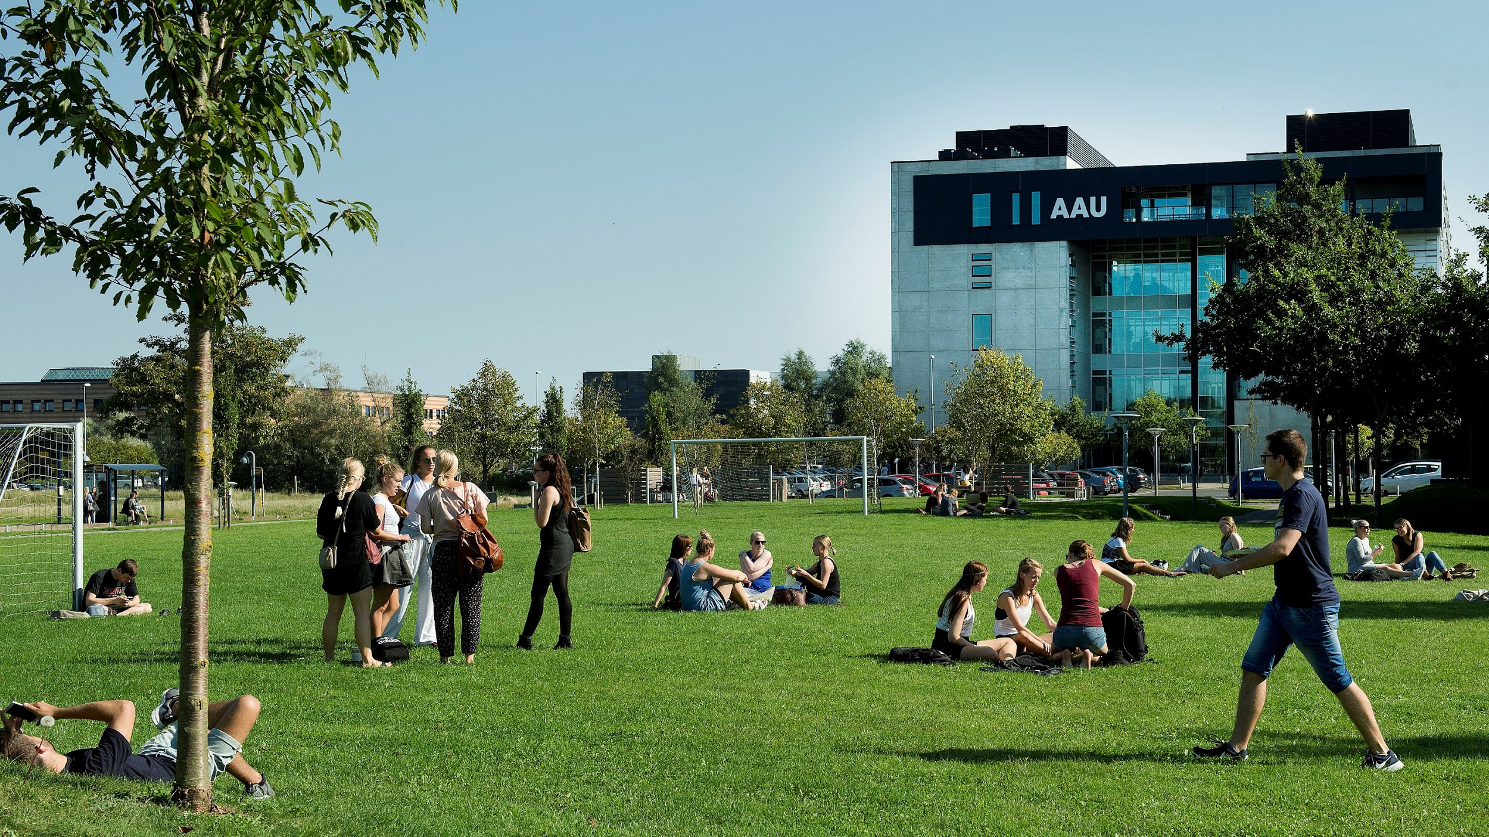
Computationally Assisted Text Analysis
Johannes Bjerva --- jbjerva@cs.aau.dk --- https://bjerva.github.io

Slide 2


Research Background
BA/MA Computational Linguistics Stockholm University, Sweden
PhD in Natural Language Processing University of Groningen, The Netherlands
Post-doc on NLP for Low-Resource Languages University of Copenhagen, Denmark
Assistant Professor (Tenure-track) Aalborg University Campus Copenhagen
Very happy to initiate collaborations
Let me know if you have a project in mind which could need some NLP input

Slide 4
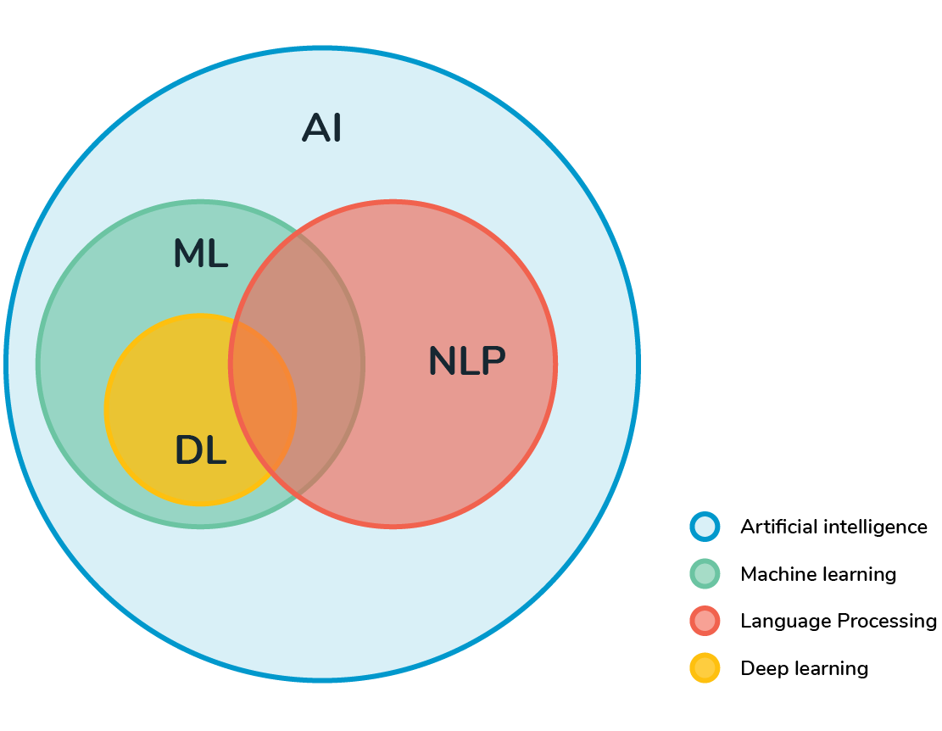
Workshop Outline
Background (~ 45 minutes)
What is Machine Learning
Deep Learning vs. Machine Learning
What is Natural Language Processing
Why is it difficult?
NLP in Digital Humanities
Hands-on NLP Pipeline (~ 45 minutes)
Step-by-step with Jupyter Notebook
Hatespeech Detection

Slide 5
Please ask questions during the presentation!
In chat
or: unmute and interrupt me :)

Slide 6
Machine Learning https://forms.gle/Edp9ktRVeESPKGyU7

Slide 7
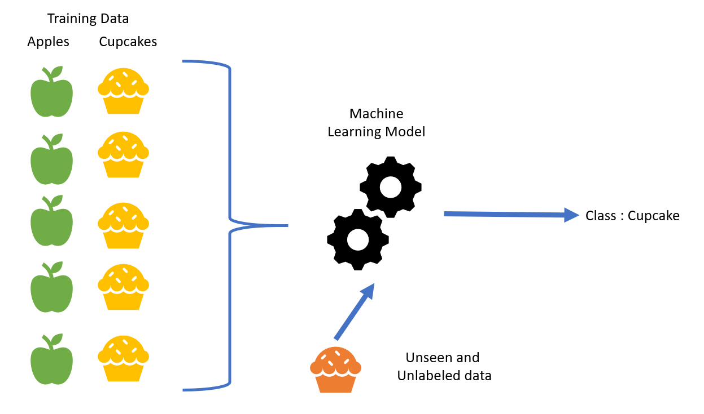

Slide 8
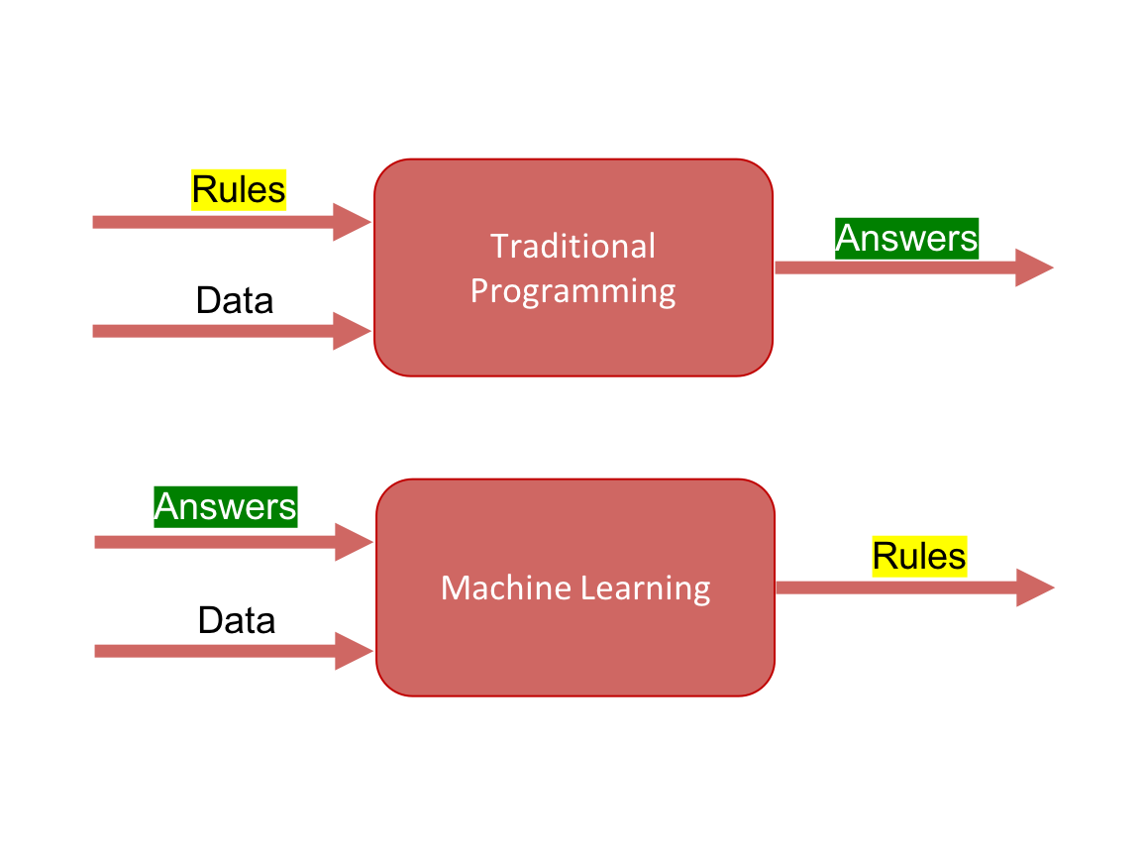
What is Machine Learning
Herbert Simon: “Learning is any process by which a system improves performance from experience.”
Arthur Samuel: “Giving computers the ability to learn without being explicitly programmed”
Tom Mitchell: “Machine Learning is the study of algorithms that:
Improve their performance (P)
For some task (T)
With some experience (E)”

Slide 9
Supervised Learning
Learning to associate
inputs X (“Data”)
to an output Y (“Answers”)
Answers / output labels (Y) must be predefined, e.g.:
Is a sentence (X) positive or negative (Y)?
Does a document (X) mention a certain person (Y) or not?
What caption (Y) goes with a picture (X)?

Slide 10

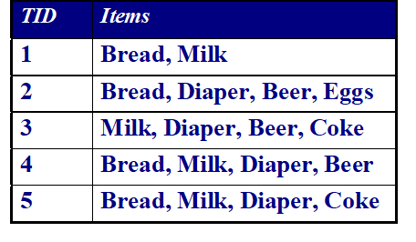
Learning associations
How likely is it that someone will buy beer (Y), if they bought diapers (X)?
Generally:
P(Y | X), probability that someone who buys X also buys Y
Out of 4 diaper purchases, 3 also bought beer
Hence: P(Y|X) = ¾ = 0.75
Given a new instance, we will likely predict that beer is bought if diapers are bought

Slide 11
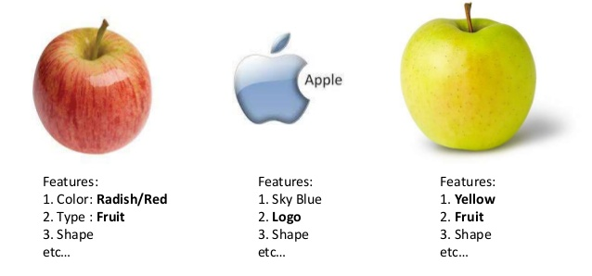
Features
“A feature is an individual measurable property of a phenomenon being observed”
Feature examples:
Diapers and beer
Color
Shape
In NLP, features are typically linguistically motivated
Words
Named Entities
Syntactic structure

Slide 12
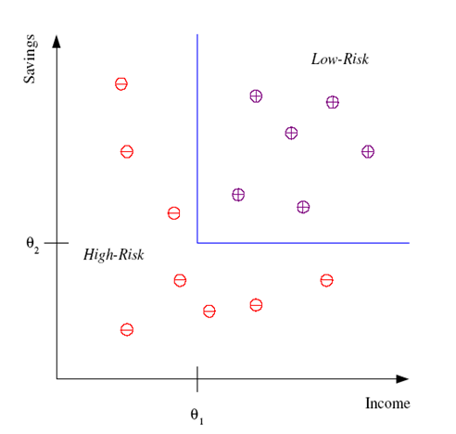
Two features and decision boundary
Given two features:
Income
Savings
Divide individuals into
Low-risk
High-risk
For a new individual, given these features, we will categorise them based on the blue line

Slide 13
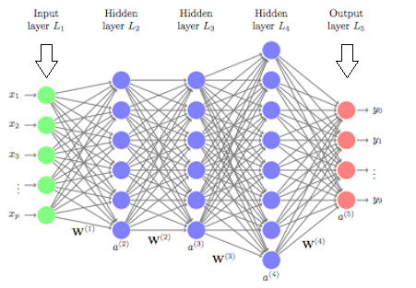
Deep Learning
Neural Networks
Input features on the left
Output categories on the right
Several hidden layers

Slide 14
Deep Learning vs. Machine Learning
In Machine Learning, features and feature combinations must be manually defined
In Deep Learning, feature combinations are automatically learned

Slide 15
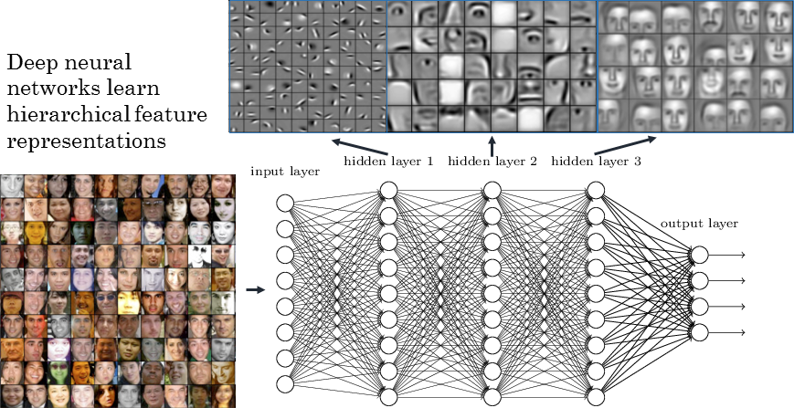
[https://www.rsipvision.com/exploring-deep-learning/]

Slide 16
Natural Language Processing

Slide 17

What is Natural Language Processing
Building computer systems that understand and generate natural languages.
Deep understanding of broad language
not just string processing or keyword matching
Speech processing
Not covered today
[NLP intro slides inspired by Isabelle Augenstein, KU]

Slide 18
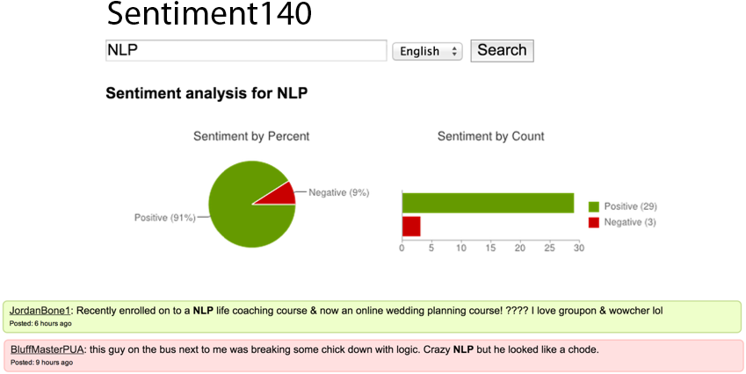
Sentiment Analysis
Notes:
Ambiguity

Slide 19
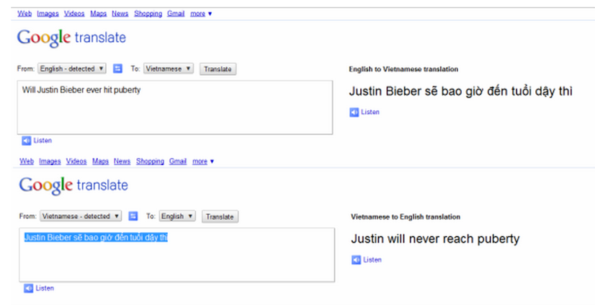
Automatic Translation

Slide 20
Automatic Translation

Slide 21
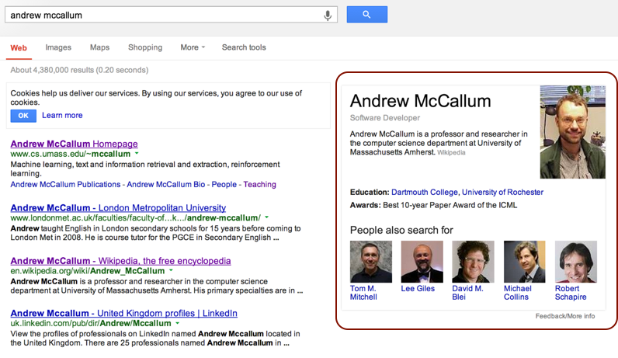
Information Extraction

Slide 22
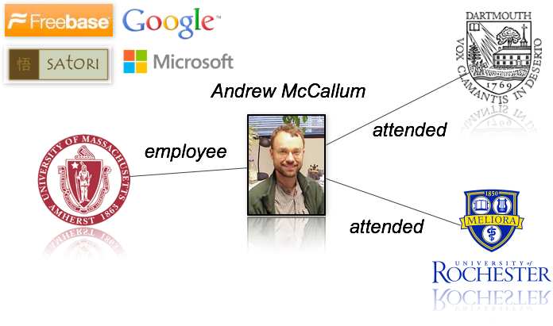
Information Extraction

Slide 23
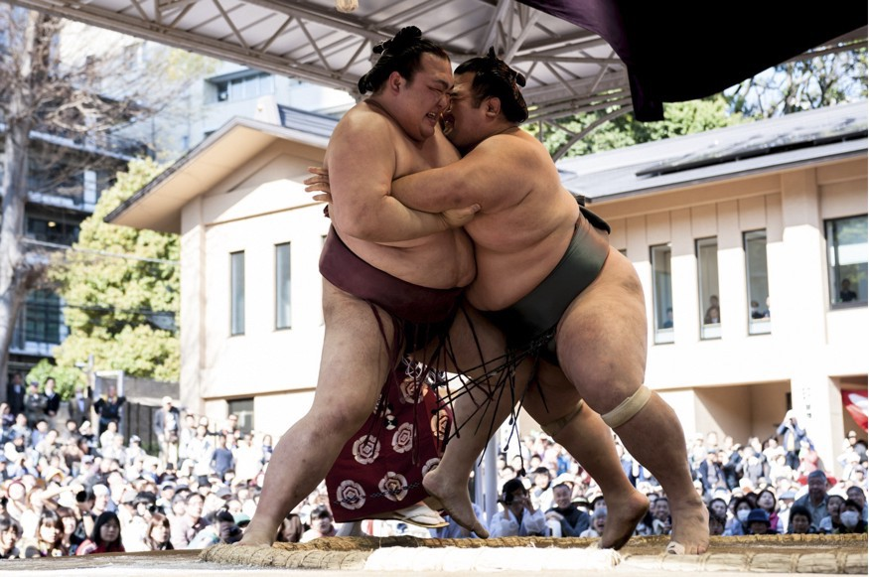
Image Captioning

Slide 24
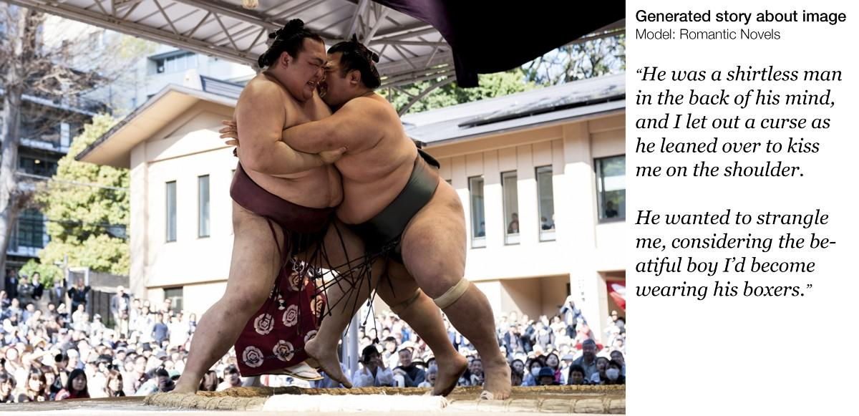

Slide 25
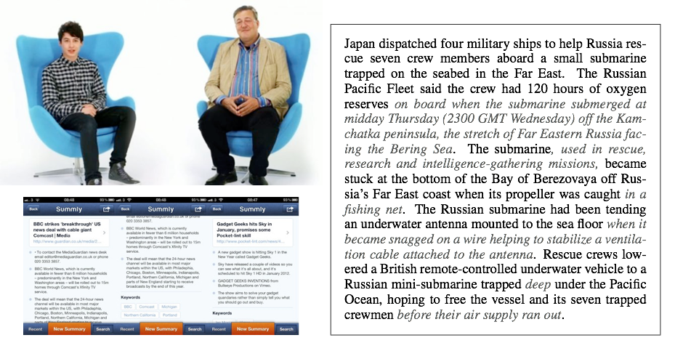
Text Summarization

Slide 26
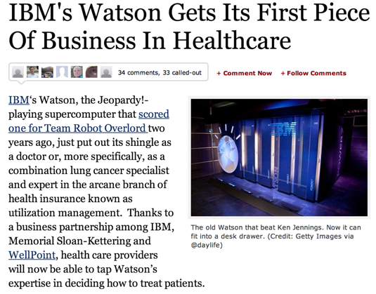
Question Answering

Slide 27
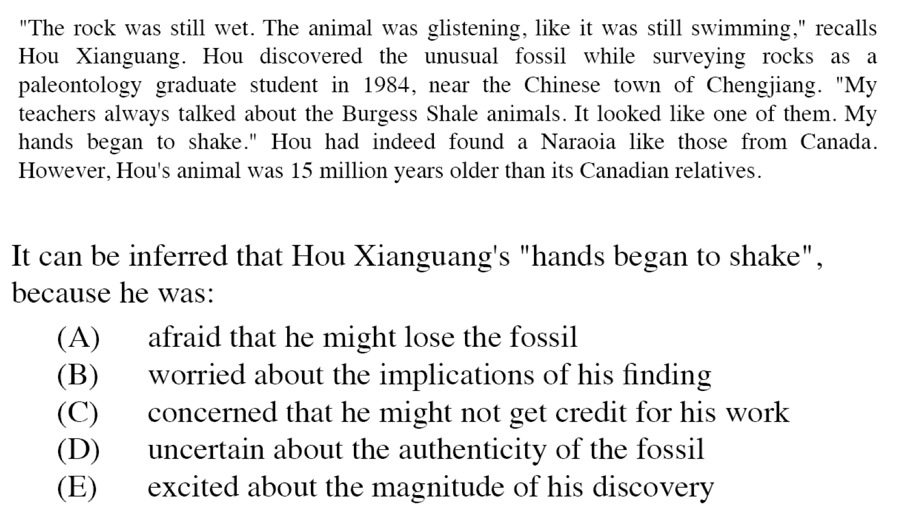
Text Comprehension

Slide 28
Break time! Your challenge for now:
How can this type of processing be relevant in my field?
Are there inputs (X) and outputs (Y) where:
We *know* the mapping for some items
We *want to know* the mapping for new items?
Potential suggestions:
Summarizing legal documents?
Finding named entities in historical texts?
Linking entities across different documents?

Slide 29
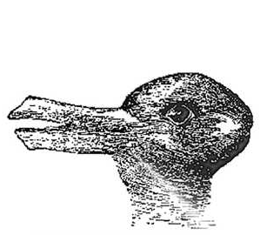
What is Difficult about NLP
Ambiguity Everywhere
“Time flies like an arrow”
Does time fly in the manner of an arrow?
Should we use a stopwatch to time flies, like we would time arrows?
Is there something called a “time fly”, and do these flies enjoy arrows?

Slide 30
What is Difficult about NLP
Ambiguity Everywhere
"Jane ate spaghetti with a silver spoon."
Do you mean...
Jane used a silver spoon to eat spaghetti? (cutlery)
Jane ate spaghetti and a silver spoon? (part)
Jane ate spaghetti in the presence of a silver spoon? (company)
Jane exhibited a silver spoon while eating spaghetti? (manner)

Slide 31
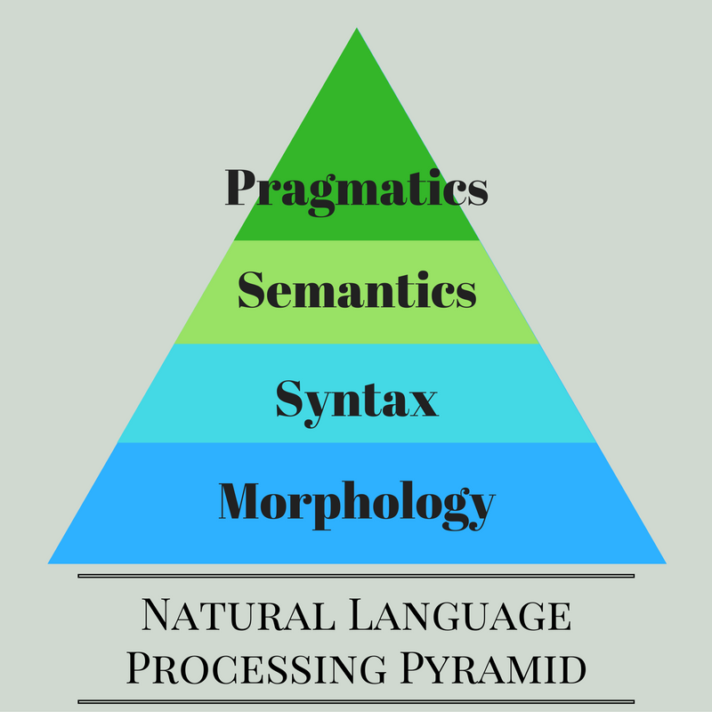
Linguistic Levels
Morphology:
Word structure
Syntax:
Sentence structure
Semantics:
“Meaning”
Pragmatics:
“Implied meaning”

Slide 32
Linguistic Levels
Lower levels are easier to define
Today:
Tools for Morphology and Syntax
Classification on a Semantic level

Slide 33
Today’s partial view on NLP
Core NLP Tasks
Tokenisation, Segmentation
Part of Speech Tagging
Language Modelling
Machine Translation
Syntactic and Semantic Parsing
Document Classification
Information Extraction
Question Answering
Core NLP Methods
Structured Prediction
Preprocessing
Generative Learning
Discriminative Learning
Weak Supervision
Representation and Deep Learning

Slide 34
Hands-on with Jupyter Notebook
https://forms.gle/v35hjkKJnraTwmbBA

Slide 35

Open the Jupyter Notebooks
Don’t worry if you
Have zero programming experience
Haven’t seen a Jupyter Notebook before
Code can be modified in a non-coder friendly way
You do not have to understand most of the code itself, beyond what is described by me / comments
If you feel lost - ask away!

Slide 36
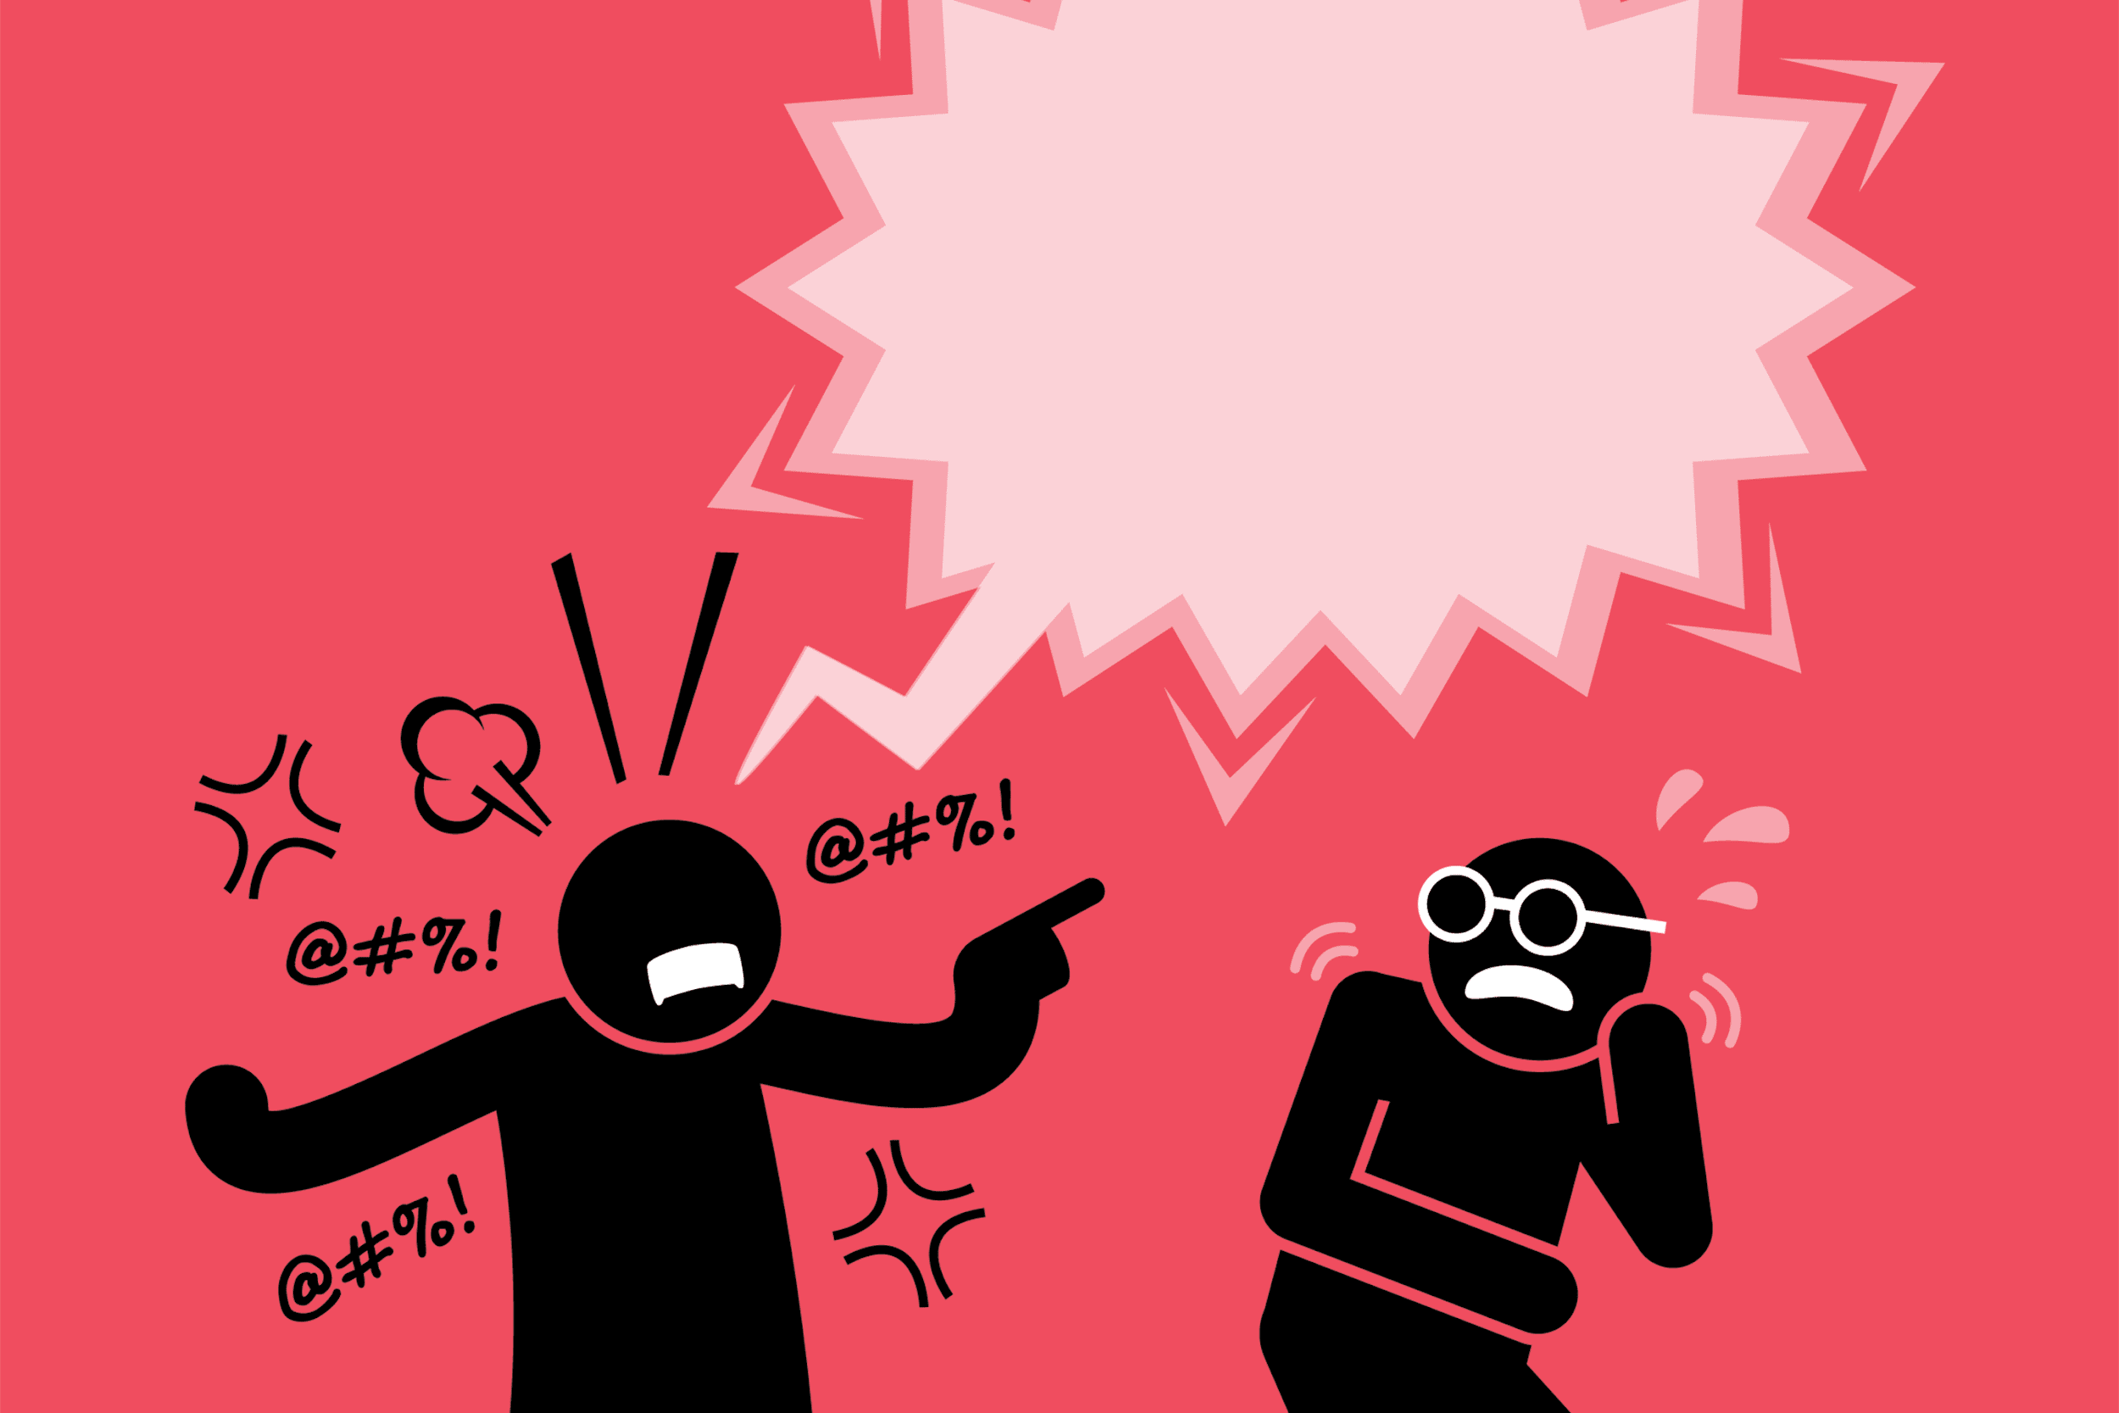
Hatespeech Detection
OffensEval 2020 (Zampieri et al., 2020)
Predict whether a tweet constitutes hate speech “public speech that expresses hate or encourages violence towards a person or group based on something such as race, religion, sex, or sexual orientation”
70 teams worldwide participated
5 languages
Arabic
Danish
English
Greek
Turkish

Slide 37
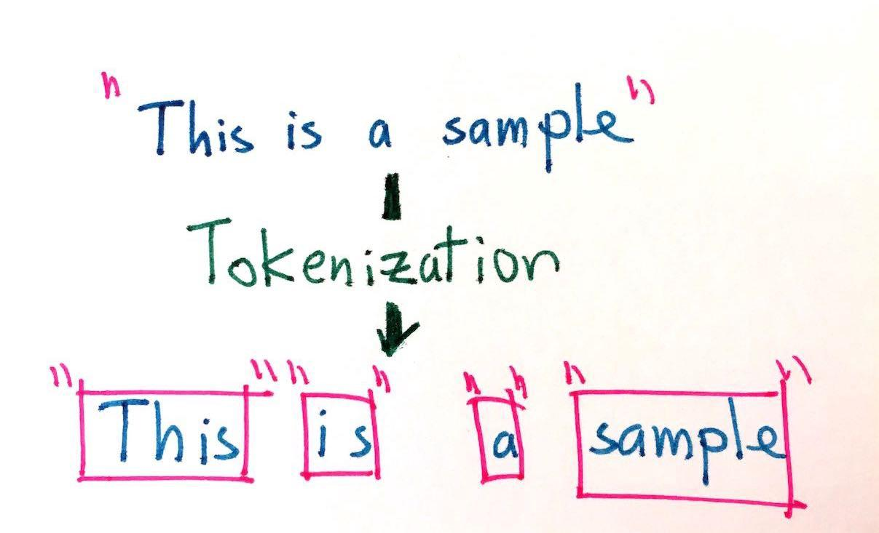
Tokenization
Dividing text into tokens
Levels of complexity:
Whitespace tokenization
Dictionary-based tokenization
Learnable tokenization
Simple tokenization fails for languages which do not use whitespace, e.g., Japanese
"今日もしないといけない。"
"今日” “も” ”しない” “と” “いけない” “。”

Slide 38
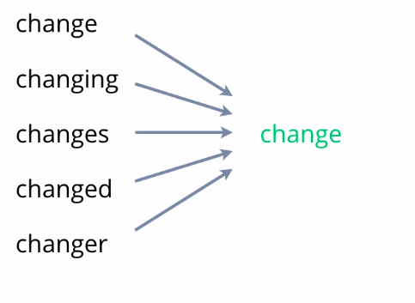
Lemmatization
Getting ‘base forms’ of words
Useful if we want, e.g., all occurrences of:
“go”, “goes”, “went” …
To be listed as:
‘Go’
Somewhat useful in English...

Slide 39
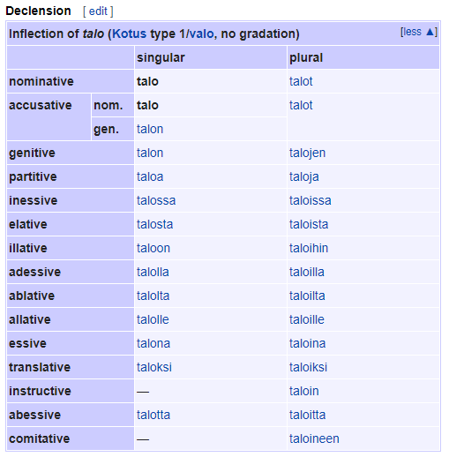
Lemmatization
Getting ‘base forms’ of words
Useful if we want, e.g., all occurrences of:
“go”, “goes”, “went” …
To be listed as:
‘Go’
Somewhat useful in English...
… even more so in morphologically complex languages

Slide 40
Part-of-Speech Tagging
Simple morphological / syntactic analysis
Divide words into parts of speech
Verbs
Adjectives
Nouns
Etc.
Tells us something about the functions of words, and resolves some ambiguities
“Time flies like an arrow”

Slide 41
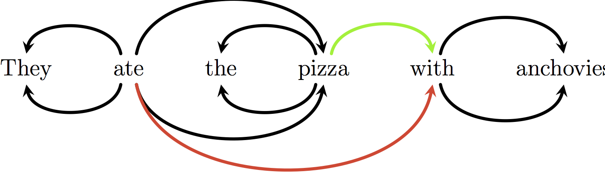
Parsing
Complex syntactic analysis on a sentence level
Finding the subjects, objects, and other syntactic roles in a sentence
“Who did what to whom”
Reduces ambiguities
Useful in most NLP where structure is relevant (i.e. almost all)

Slide 42
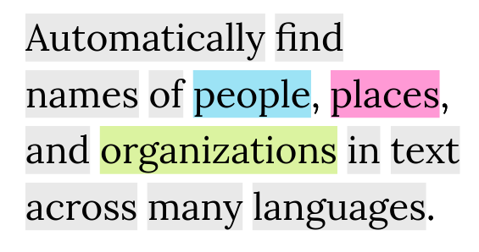
Named Entity Recognition
Semantic analysis, identifying names in a text
E.g. “Copenhagen”, “New York”
Difficult when a named entity covers several tokens

Slide 43
Machine Learning Model with NLP input
Labels: OFF / NOT
Features:
Named Entities
Tokens
POS
...

Slide 44
Deep Learning in NLP

Slide 45
Deep Learning in NLP
- Requires computing resources
+ Much more powerful
- Less interpretability

Slide 46
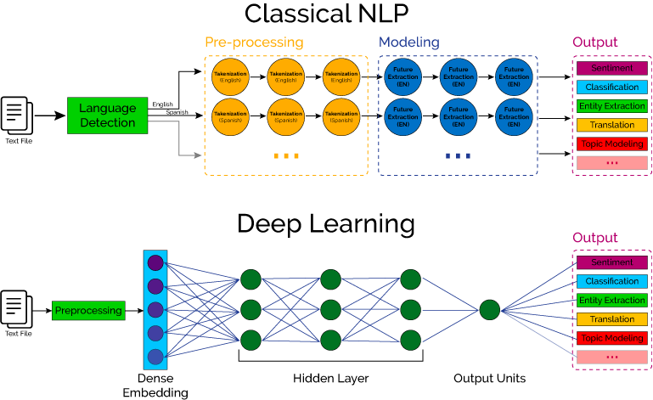

Slide 48
Distributional Semantics
John Firth, 1957:
“You shall know a word by the company it keeps”

Slide 49
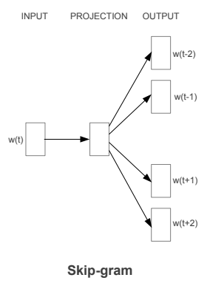
Representing Words as Vectors

Slide 50
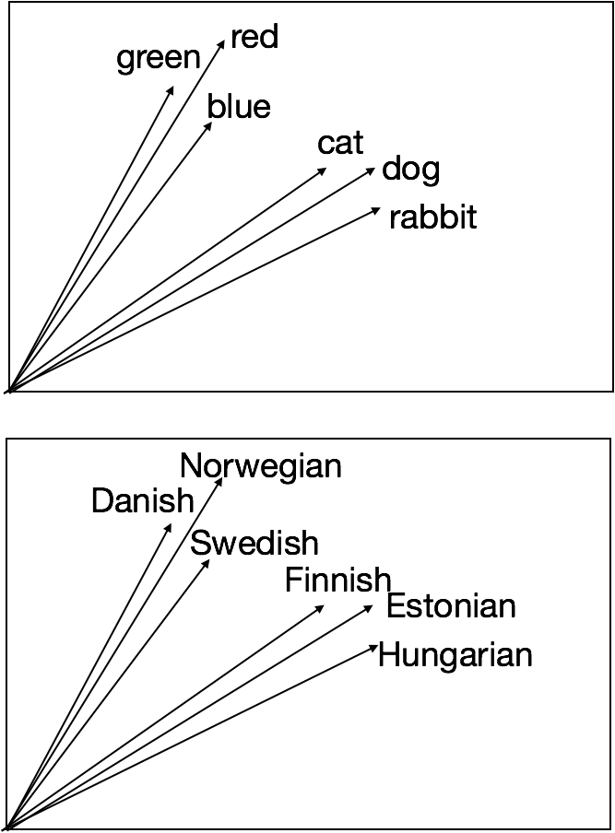
Representing Words as Vectors

Slide 51
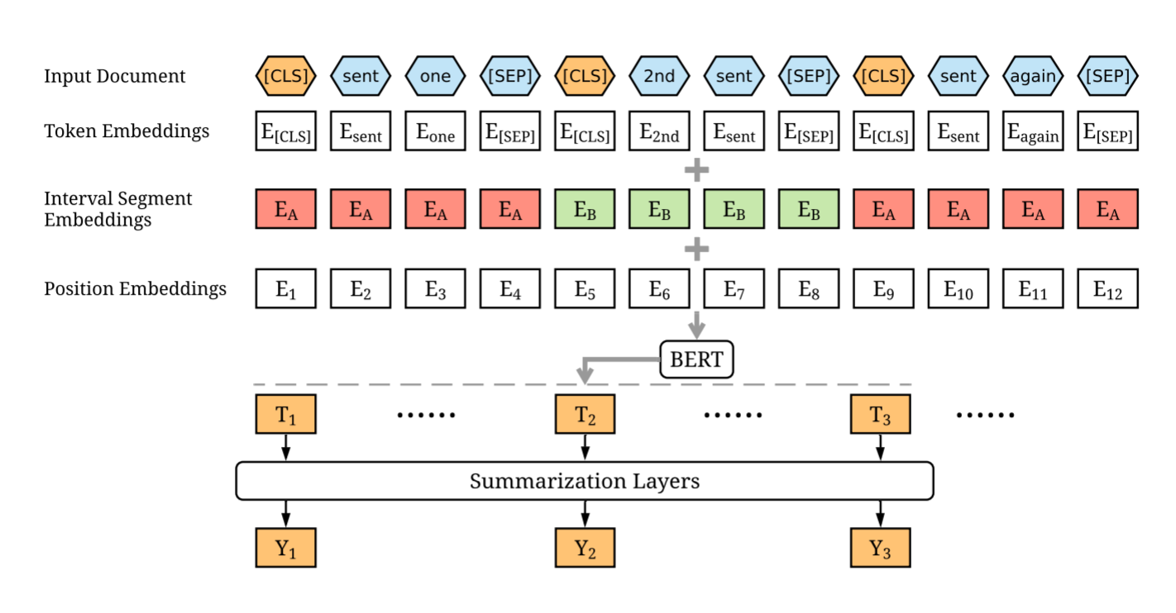
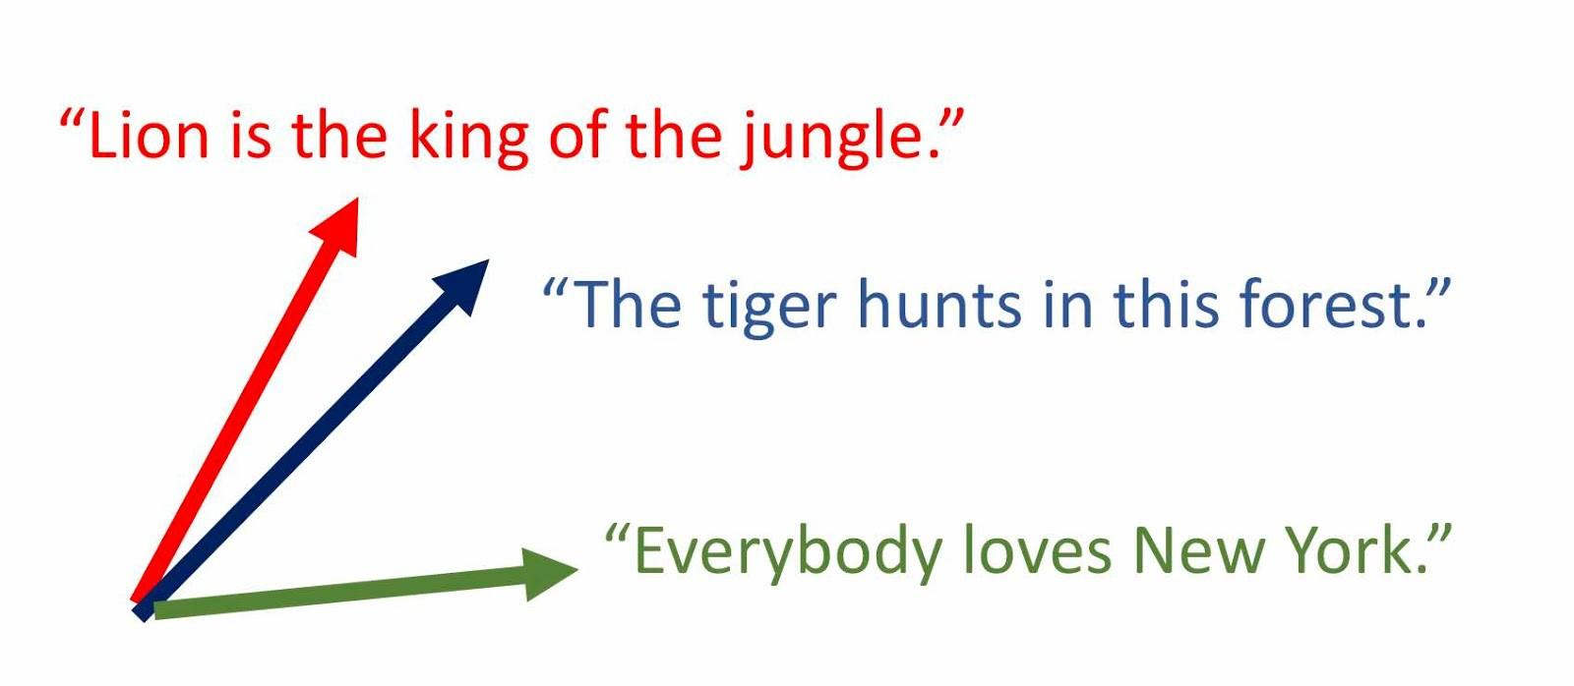
Representing Sentences as Vectors

Slide 52
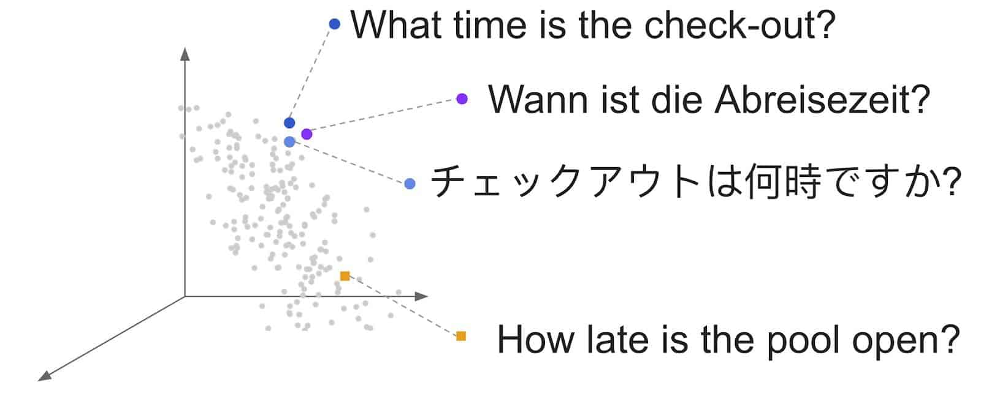
Multilingual Sentence Representations

Slide 53
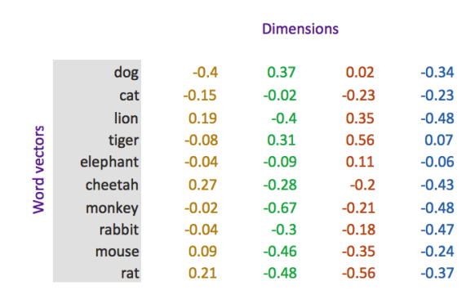
Vector Inputs to Machine Learning
Labels: OFF / NOT

Slide 54
Questions? Reach out if you want to discuss ideas for collaboration: jbjerva@cs.aau.dk

